Slide 1
IET Review-2
Grievances Registration and Management System
-Hafil. A
-22bct017

Slide 2
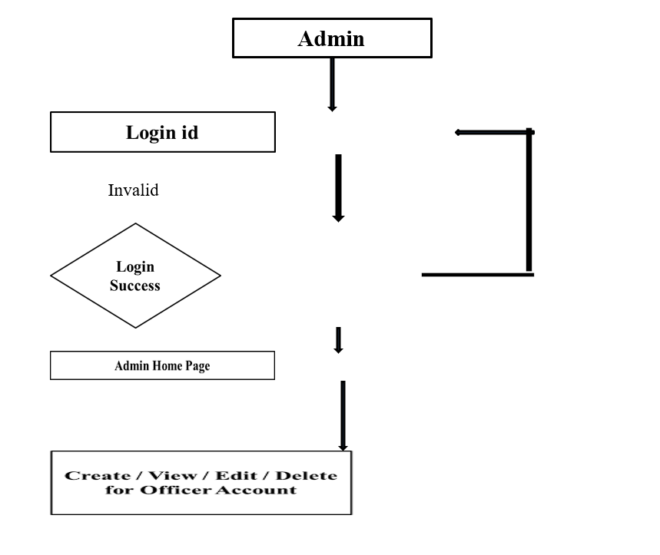
ENTITY RELATIONSHIP DIAGRAM- ADMIN

Slide 3
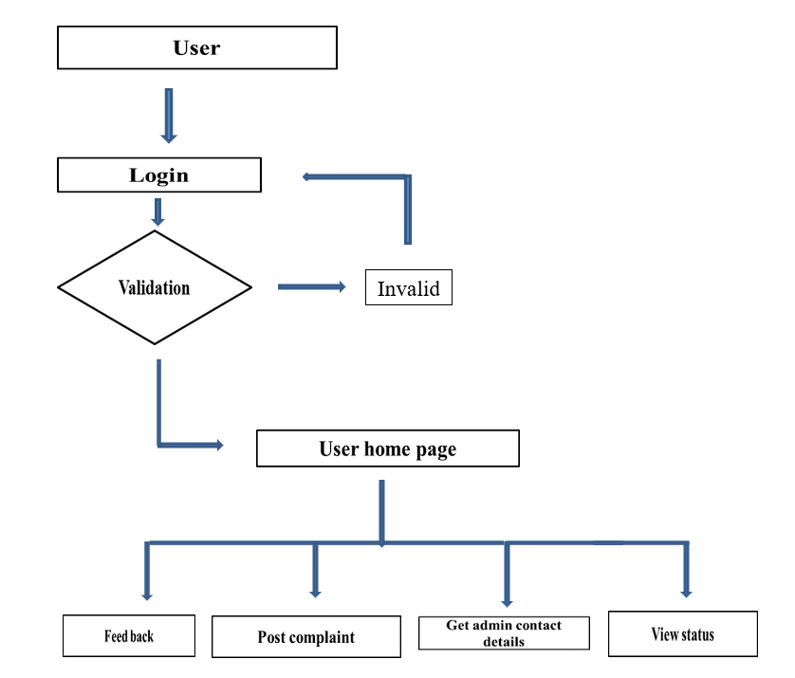
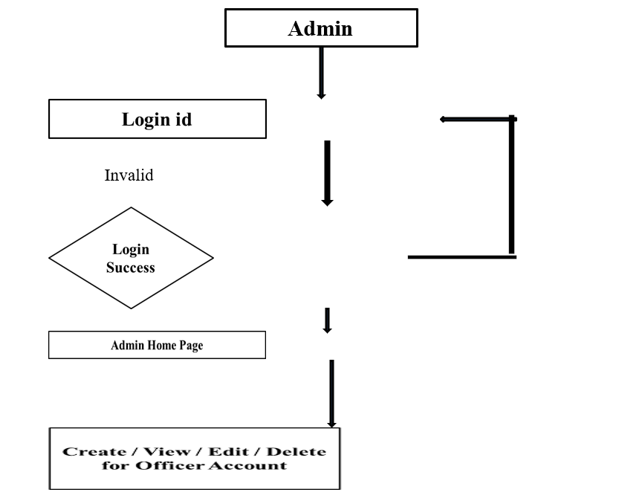
ENTITY RELATIONSHIP DIAGRAM- ADMIN

Slide 4
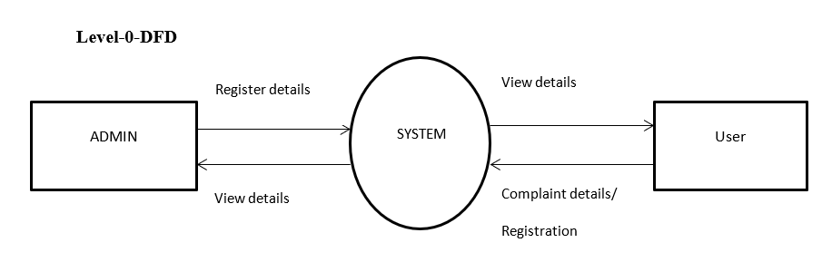

Slide 5
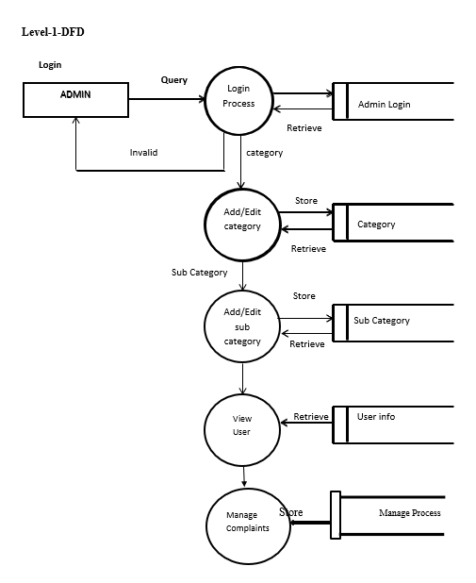

Slide 6
Module Description
System Modules:
USER
  Login
  Register
  Post Complaint
  View complaint status
  Feedback
  Get Admin Contact details

Slide 7
Module Description
System Modules:
ADMIN
  The administrator has the full-fledged rights over the GMS.
  Can create/delete an account.
  Can view the accounts.
  Can change the password.
  Insert the information available on GMS.

Slide 8
Module Description
Login Module
The main activities in the application are the user login page for user. The other modules are followed by this login page. This module records only user and password of the user.
Registration Module
Another main function of our proposed system is registration, in order to register with the unique application details such as name; password, email, place and time are required.
USER
Post Complaint: User posts their complaint through this application. That is they can’t get water regular manner in their area and about the problem description.
View Status: User views the status about their complaint.
Feedback: User gives the feedback about the actions taken on the registered complaints.
Get Admin Contact Details: User views the status about their complaint.

Slide 9
Module Description
ADMIN
View Complaint
The admin views the complaint details posted by the users.
Update Status
The admin updates the status for the user.
Update completed proof
The admin updates the photo proof of work

Slide 10
THANK
  YOU

